Slide 1
Public Finance Statistics in Nepal
15th Ashwin, 2081 (Tuesday)
Dr. Anil Shrestha
Undersecretary (Account)
Financial Administration Section
National Statistics Office, Thapathali, Kathmandu

Slide 2


Slide 3
Guess the countries…
Given the public finance statistics, guess the country type (least-developed, developing, or developed)
Country | Total Debt (% GDP) | Tax revenue (% GDP) | Customs (% of Tax Revenue) | Military Exp (% GDP) | Out-of-pocket expenditure (% health expenditure) | Health Exp (% GDP) | Inflation %
1.XXX | 47.2 | 9.1 | 3.5 | 1.7 | 35.8 | 2.9 | 2.1
2.XXX | 208.9 | 27.2 | 0 | 2.7 | 36.1 | 4.2 | 0.6
3.XXX | 46.5 | 12 | 4.9 | 2.4 | 53.2 | 1 | 3.9
4.XXX | 197.3 | 11.7 | 1.6 | 1 | 13 | 9 | 1
5.XXX | 30 | 19.1 | 18.4 | 1.3 | 57.7 | 1.1 | 4.1
6.XXX | 98.4 | 9.9 | 2.6 | 3.3 | 11.3 | 8.6 | 2.4

Slide 4
Guess the countries…
Now, guess the country (China, India, Nepal, US, Greece, Japan)
Country | Total Debt (% GDP) | Tax revenue (% GDP) | Customs (% of Tax Revenue) | Military Exp (% GDP) | Out-of-pocket expenditure (% health expenditure) | Health Exp (% GDP) | Inflation %
1.XXX | 47.2 | 9.1 | 3.5 | 1.7 | 35.8 | 2.9 | 2.1
2.XXX | 208.9 | 27.2 | 0 | 2.7 | 36.1 | 4.2 | 0.6
3.XXX | 46.5 | 12 | 4.9 | 2.4 | 53.2 | 1 | 3.9
4.XXX | 197.3 | 11.7 | 1.6 | 1 | 13 | 9 | 1
5.XXX | 30 | 19.1 | 18.4 | 1.3 | 57.7 | 1.1 | 4.1
6.XXX | 98.4 | 9.9 | 2.6 | 3.3 | 11.3 | 8.6 | 2.4

Slide 5
Guess the countries…
Did you get it correct? How public finance statistics helped you to identify the country?
Country | Total Debt (% GDP) | Tax revenue (% GDP) | Customs (% of Tax Revenue) | Military Exp (% GDP) | Out-of-pocket expenditure (% health expenditure) | Health Exp (% GDP) | Inflation %
1.China | 47.2 | 9.1 | 3.5 | 1.7 | 35.8 | 2.9 | 2.1
2.Greece | 208.9 | 27.2 | 0 | 2.7 | 36.1 | 4.2 | 0.6
3.India | 46.5 | 12 | 4.9 | 2.4 | 53.2 | 1 | 3.9
4.Japan | 197.3 | 11.7 | 1.6 | 1 | 13 | 9 | 1
5.Nepal | 30 | 19.1 | 18.4 | 1.3 | 57.7 | 1.1 | 4.1
6.US | 98.4 | 9.9 | 2.6 | 3.3 | 11.3 | 8.6 | 2.4

Slide 6
Learning Objectives

Slide 7
Learning Objectives
Understanding the concept and scope of Public Finance Statistics (PFS)
Appreciate the importance of PFS
Identify major data sources and methods for collecting PFS
Recognize the challenges and limitations in collecting and analyzing PFS
Learn about the standard practice of PFS compilation

Slide 8
What is Public Finance Statistics?

Slide 9
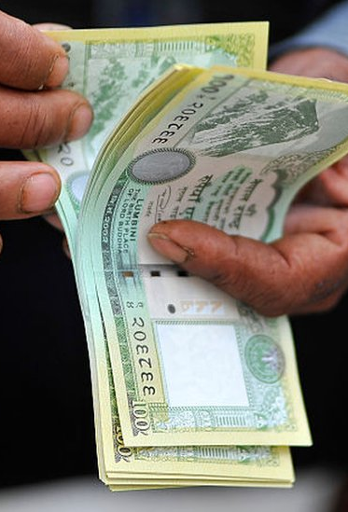
What is Public Finance Statistics?
It's about measuring and tracking how governments raise, spend, and manage their funds.
It also comprises government controlled public corporations fund operations.

Slide 10
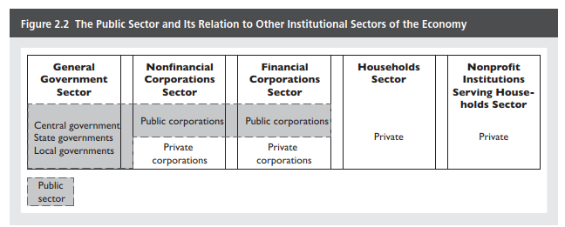

Slide 11
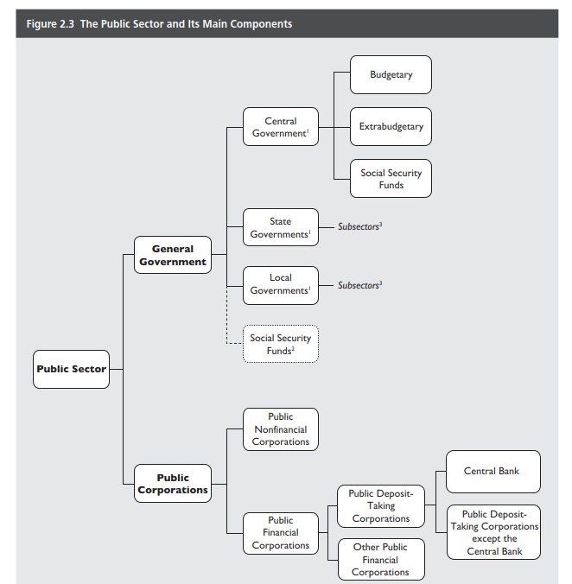
Group work 1:
Where do these units belong in the chart? Why?
Kathmandu Metropolitan City
National Statistics Office
Public Service Commission
Bagamati Province Govt
Rastriya Banijya Bank
Social Security Fund
Provident Fund
Nepal Oil Corporation
Rastriya Beema Company
Nepal Telecom
Nepal Telecom Authority
University Grant Commission
Nepal Police School, Sanga
Bir Hospital
Norvic Hospital

Slide 12

Let’s discuss
Sources of funds
???
Utilization of funds
???
Sources of data
???

Slide 13
Sources of funds
1. Taxes
Income tax (personal and corporate)
Sales tax / Value Added Tax (VAT)
Property tax
Excise duties
2. Non-tax revenues
User fees and charges for government services
Fines and penalties
Profits from state-owned enterprises
3. Borrowing (domestic/international)
4. Grants and foreign aid
5. Sale of government-owned resources

Slide 14
Utilization of funds
1. Recurrent expenditure
Compensation of employees
Use of goods and services
Interest
Grants
Subsidies etc.
2. Capital expenditure
Physical infrastructure
Machinery and Equipment
Vehicles
Land and Building
3. Financial arrangement/investments
Principal repayment
Share investment
Loan investment

Slide 15
Sources of data
Ministry of Finance (LMBIS, AIMS, Red Book etc.)
Financial Comptroller General Office (RMIS, TSA, IPFMS, PAMS)
Public Debt Management Office
Nepal Rastra Bank
Pension Management Office
Inland Revenue Department
Custom Department

Slide 16
Group work 2: Identify the sources and utilization of funds, and their data sources for the units circled.
Sources of funds
Utilization of funds
Sources of data

Slide 17

Accrual vs Cash-based accounting

Slide 18
Accrual vs Cash-based accounting
Cash basis: transactions are recorded when cash is received or paid.
Accrual basis: transactions are recorded when they occur, regardless of cash flows.
Pros vs Cons
Cash based accounting easier to maintain but does not provide complete picture of economic transactions.
Accrual basis accounting is relatively difficult to maintain but provides a complete picture of economic transactions.

Slide 19
Which accounting system is followed by the units of the Public Sector in Nepal?

Slide 20
Federal, State, and Local governments are using cash-based and other units principally using accrual-based accounting system.

Slide 21
Group work 3:
Suppose you are asked to compile the sources and utilization of funds in the Public Sector of Nepal. Now, perform the following tasks.
Prepare an outline of sources and utilization of funds with potential item-heads.
List out the possible challenges during the compilation process.

Slide 22
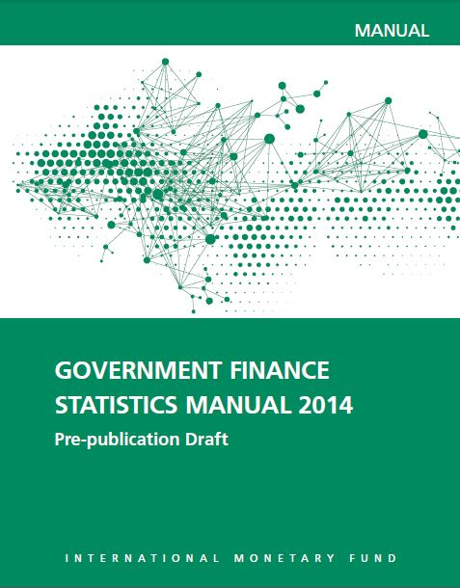
What guides the standard practice of Public Finance Statistics compilation?

Slide 23
Beyond source and utilization of funds in the Public Sector

Slide 24
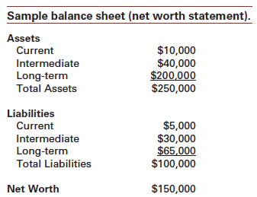

The concept of Balance Sheet and the Net Worth

Slide 25
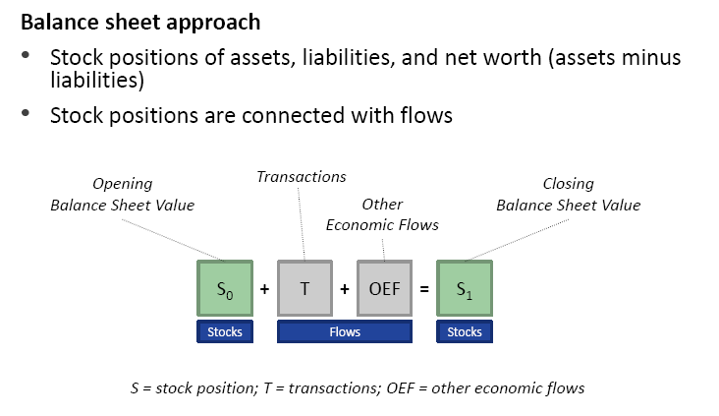

Slide 26
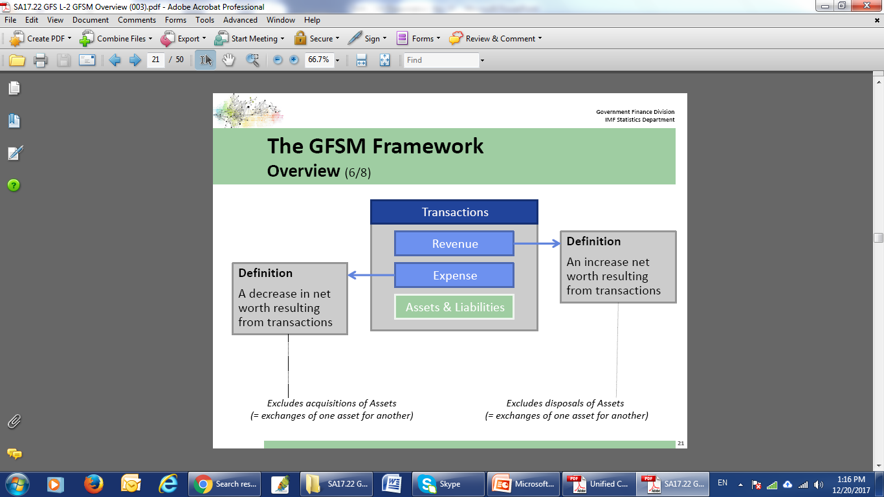

Slide 27
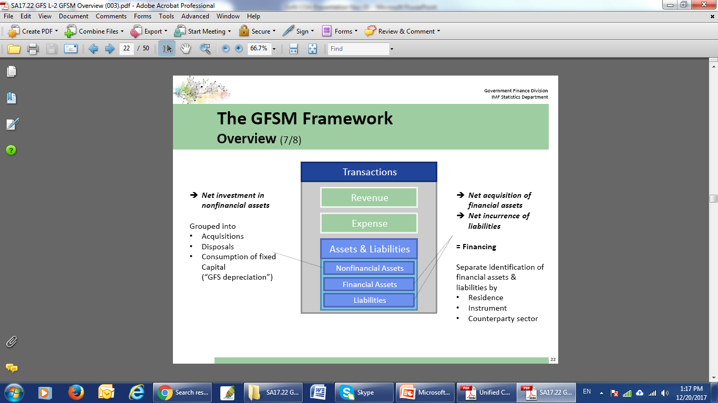

Slide 28
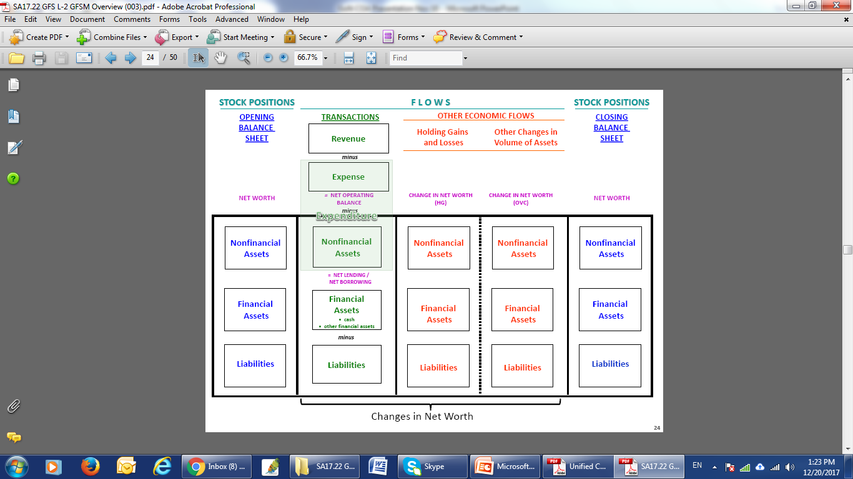

Slide 29
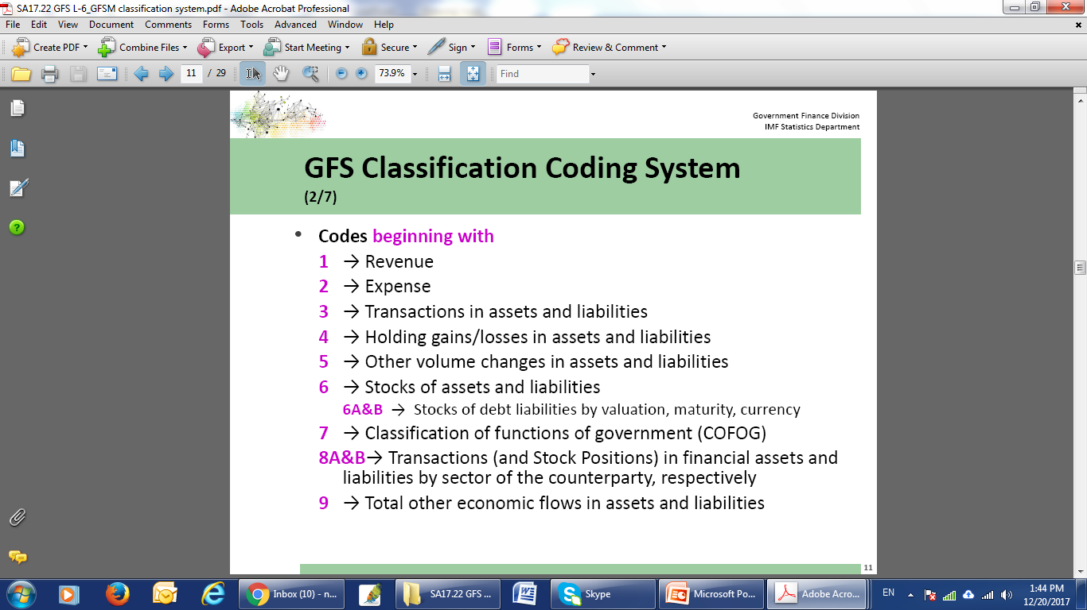

Slide 30
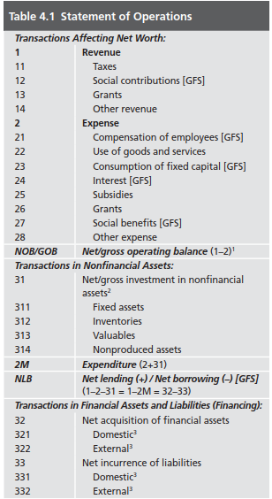
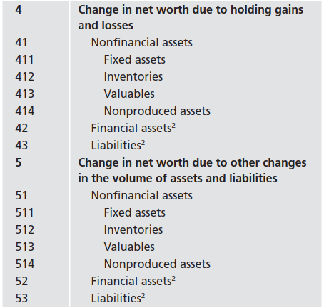
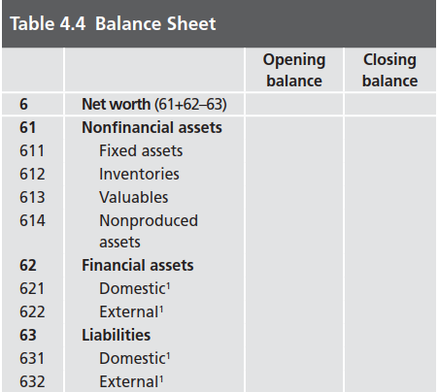

Slide 31
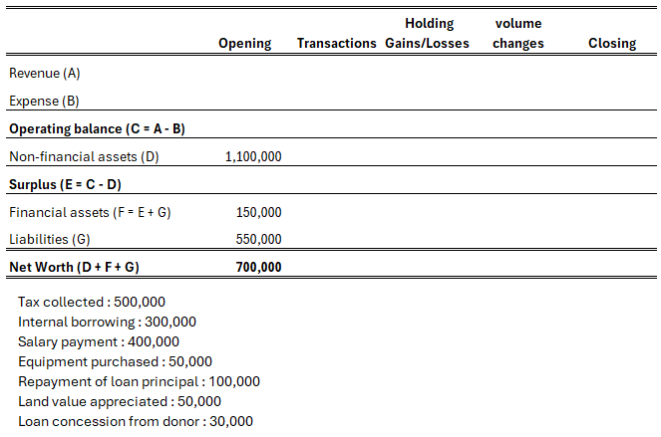
Group work 4:
Calculate closing net worth based on the transactions provided

Slide 32
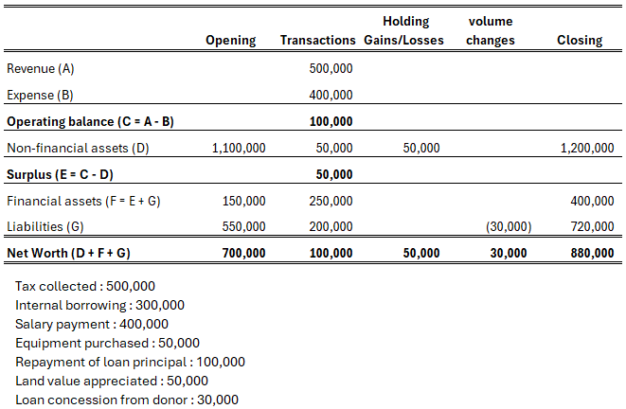

Slide 33
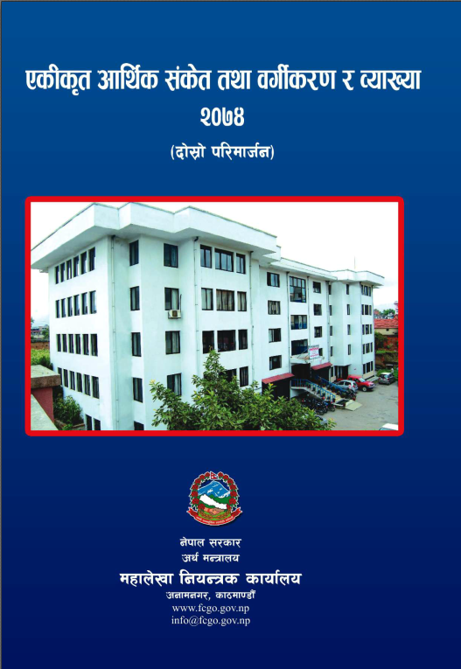
Government Finance Statistics framework: The Charts of Accounts

Slide 34
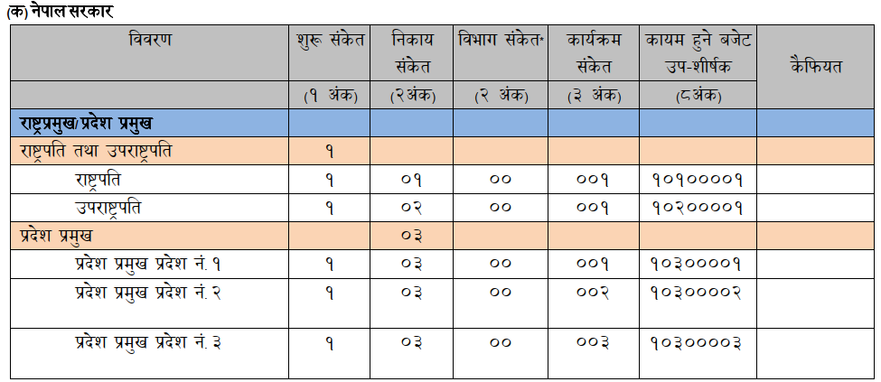
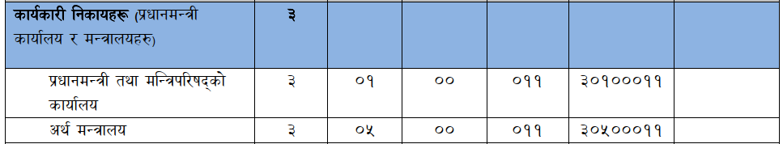

Slide 35
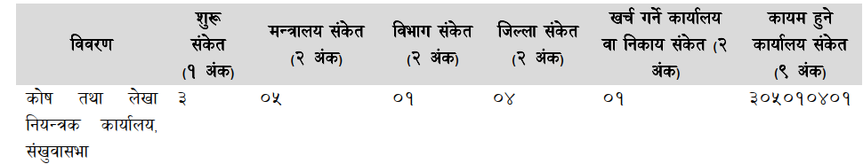

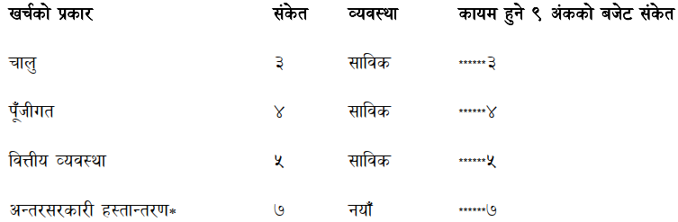

Slide 36

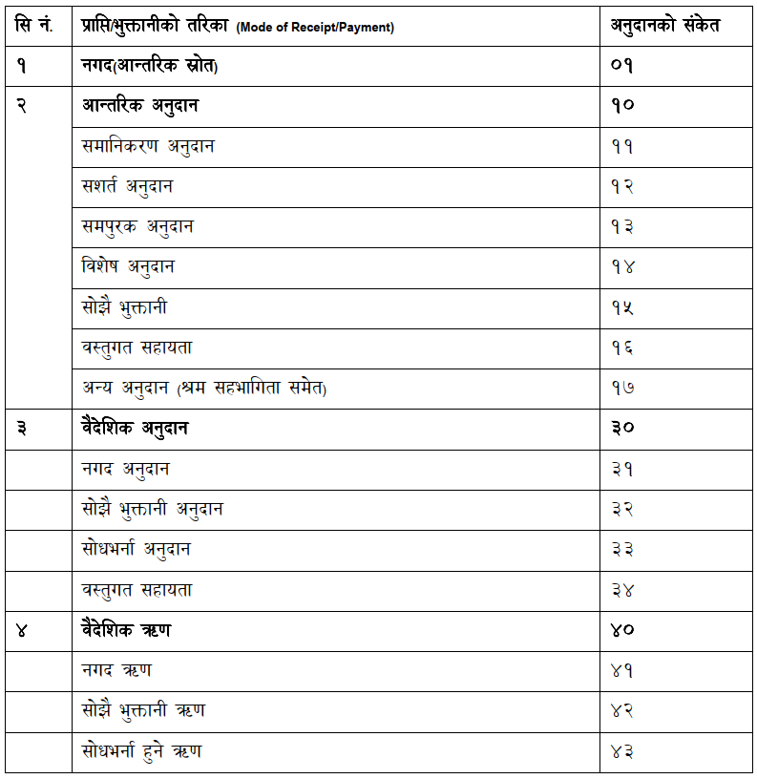

Slide 37

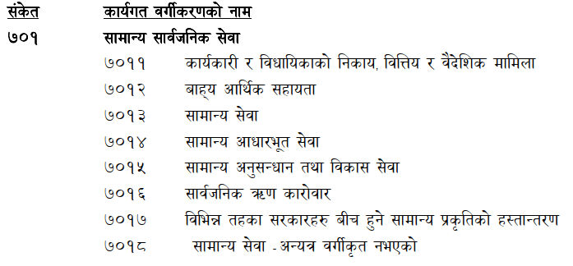
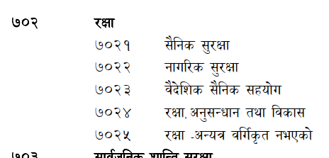

Slide 38
Any Question?

Slide 39
Thank You

